Slide 1
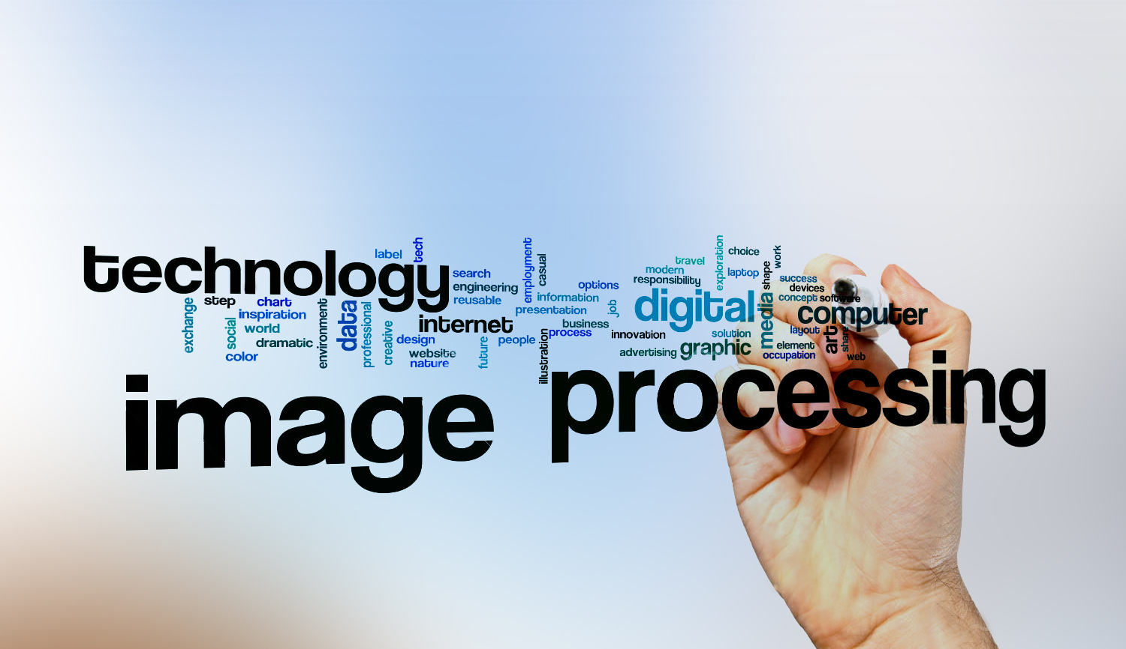
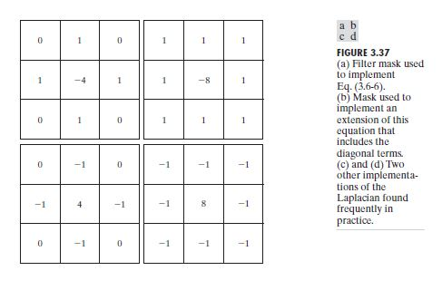
Digital Image Processing
21- sharpening filter

Slide 2
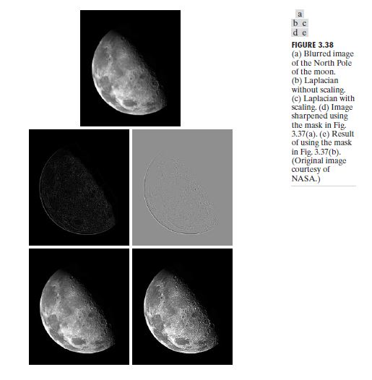
Digital Image Processing
21- sharpening filter

